Slide 1
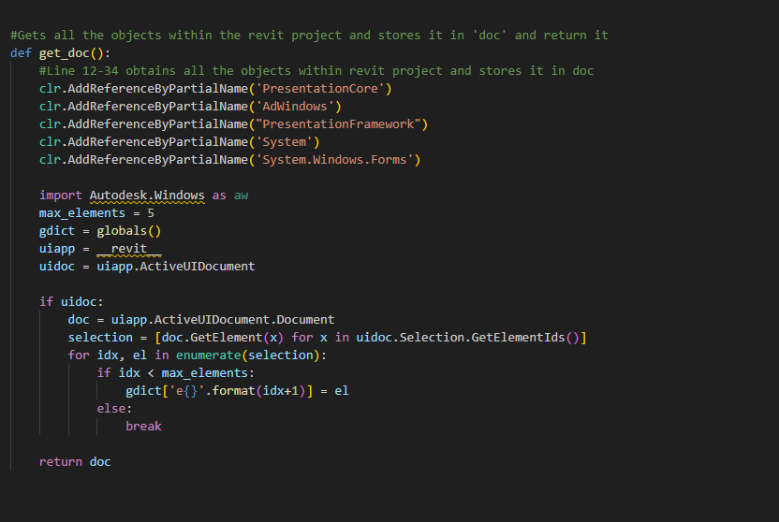
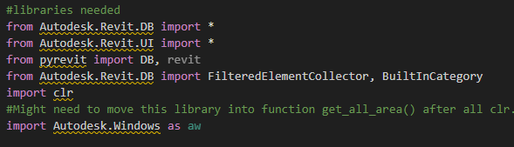
Obtains all the objects within the revit project (i.e areas, walls, window, etc.) and stores it in doc and returns it.

Slide 2
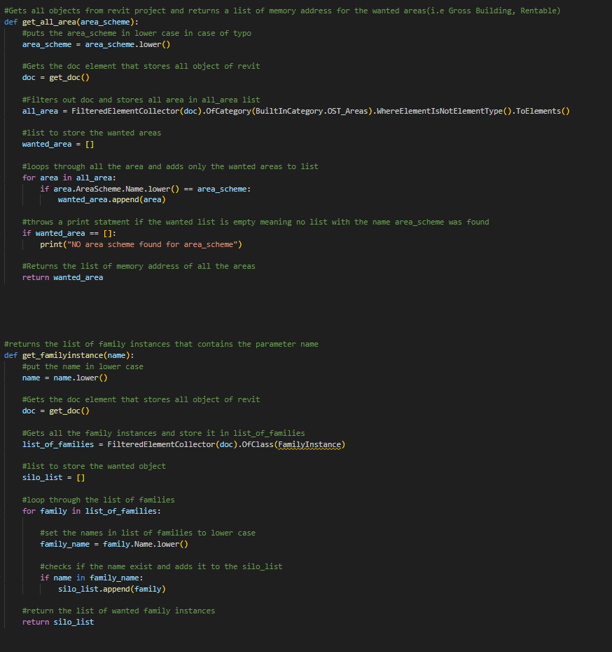
get_all_area() –
Filters out the doc(which contains all the objects) and only get the areas with the given wanted area scheme.
Given a area scheme name it returns all the area with that area scheme name.
Get_familyinstance() –
Filters out the doc and only get the family instance with the given name.
Given a family instance name it returns all the family instance with that name.
FamilyInstance are all the custom object that are not part of the revit default objects.

Slide 3
How to Add PyRevit
After downloading Revit, download PyRevit using the link below
Releases · eirannejad/pyRevit (github.com)
Open and run the downloaded PyRevit. Finish the setup and a ‘pyRevit’ tab will appear in the Revit software.

Slide 4
Creating a new tool in Revit using pyRevit
Create a Folder to store the tool, give it a name (i.e pyrevitfolder)
Within the name create a Folder with .extension (i.e tool.extension)
Within the .extension folder create a .tab folder the name given to this folder will be the name that appears in the Revit tab (i.e Helper.tab)
Within the .tab folder create a .Panel folder which contains the tool/s that area created. (i.e Info.Panel NOTE: a .tab folder can contain multiple .panel folder which appears in different order depending on your bundle.yaml file)

Slide 5
Creating a new tool in Revit using pyRevit(continue)
The .panel folder will contain the actual buttons/tools. The most common types are .pushbutton and .urlbutton folders. Where .pushbutton performs a action and .urlbutton is a hyperlink that opens a url. (.panel folder also needs a bundle.yaml file to order different tools)
If a .panel folder contains multiple tools you can organize it using .stack and .pulldown (most common types) folderswhich also contains a bundle.yaml file
Within the .pushbutton folder it must contain 3 files, a bundle.yaml file, a icon.png file(can be .jpg or .jpeg), and a script.py file. While .urlbutton folder only contain 2 files, bundle.yaml and icon.png file (NOTE: The names of the files cannot be changed)

Slide 6
PyRevit Folder Hierarchy
bundle.yaml
(organization)
.pulldown / .stack Folder
pyRevit Folder
.extension Folder
.tab Folder
.panel
Folder
.pushbutton/ .urlbutton Folder
bundle.yaml
(organization)
bundle.yaml
(tool creation)
icon.png
script.py

Slide 7
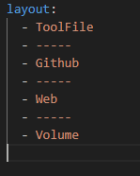
bundle.yaml
The bundle.yaml file is commonly used for 2 purpose in pyRevit, organization and tool creation.
For organization you use layout:
Where you write the name of the folders in the order you want it to appear

Slide 8


.urlbutton folders
Contains 2 files, a bundle.yaml file and a icon.png file
icon.png file is the icon of the tool that will appear in revit
bundle.yaml file creates the tool. Must contain title and hyperlink where title is name of tool and hyperlink is the website that will open once the tool is clicked on. Tooltip & author is optional

Slide 9

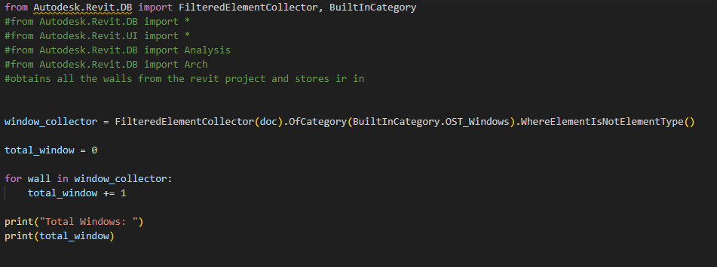
.pushbutton folder
A .pushbutton folder contains 3 files, bundle.yaml file, icon.png file, and script.py file.
The icon.png file is the icon of the tool that will appear in revit
The bundle.yaml creates the tool gives the description and name of the tool. (Note: title is mandatory, while tooltip & author is optional)
The script.py performs the operation. (Can be combined with different files like .xaml files to create more complex tools)

Slide 10
Note about script.py and pyRevit
PyRevit uses IronPython 2.7 which means any library created after python 2.7 cannot be used in pyrevit like shapely library
All things in Revit like windows and walls are treated as objects
All custom created objects in Revit are called FamilyInstances
To get the desired object you must filter the objects using FilteredElementCollector() in pyrevit
when changing properties(such as deletion, adding) you must start a transaction and end it (i.e using .start() & .commit()) using the transaction library in pyrevit or else a bug will occur(i.e 2 people being allowed to work on the same object and random one is saved)
when deleting items "fused" items are deleted as well(i.e you delete a wall but that wall had a windows on it along with doors and other stuff) therefore deletion in pyrevit returns a list of deleted "fused" items

Slide 11
Resources for PyRevit
Index — pyRevit 4.5 documentation (pyrevit1.readthedocs.io)
Revit API Docs
https://www.youtube.com/@AussieBIMGuru
pyRevit – YouTube
Libraries to know in PyRevit
FilteredElementCollector
BuiltInCategory
Transaction
DB

Slide 12
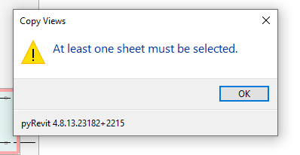
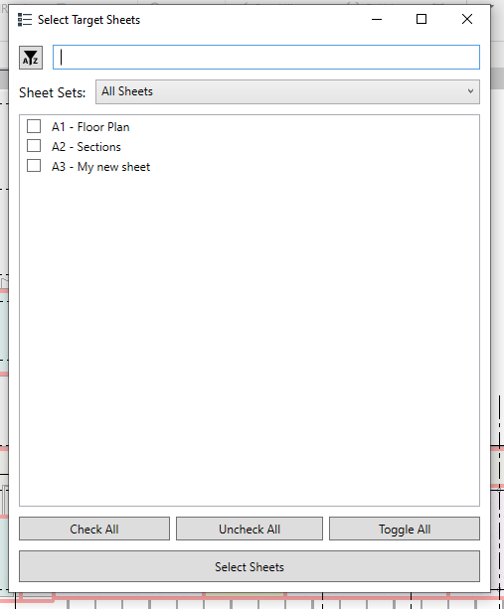
UI in pyRevit
PyRevit itself posses very limited UI options like TaskDialog using pyrevit UI library and SelectFromList using pyrevit forms library
Therefore, for better and complex UI, xaml is the best choice.

Slide 13
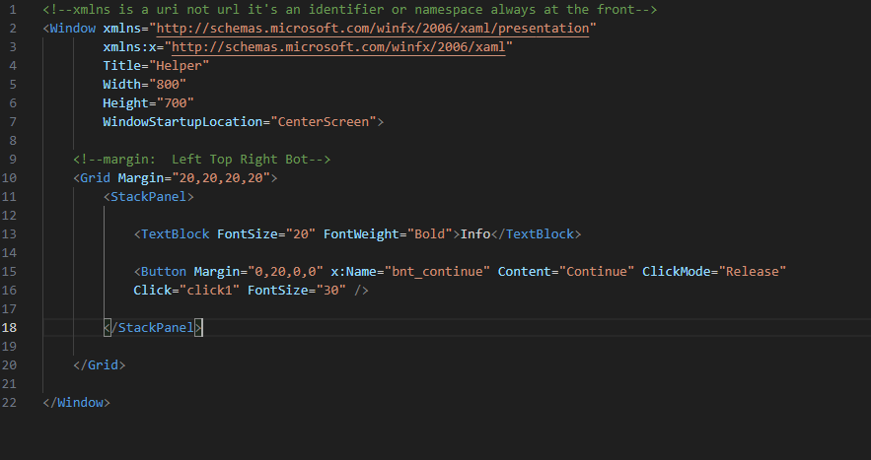
Brief overview of xaml
Xaml is a form of xml which is used to design software and apps which is very similar to html that is used to design websites. As html is a branch of xml.
visual studio(NOT vscode) allows users to design xaml files much easier with less typing and a side view of what the code will produce

Slide 14
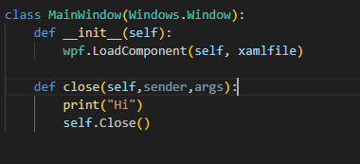
Brief overview of xaml(continue)
IMPORTANT: When using python and xaml in pyrevit to create a pop-up windows. The windows follows a tree hierarchy, where the first window is the root and any other window after that is the branches. Therefore, if you close(use the .Close() function) the main window or the root window and try to open another window revit itself will crash. Because you cannot go to the branch when the root doesn’t even exist.
Once you call the close function to close the main/root window you will not be able to do any actions within that method as it will result in revit to crash. The code below will result in a crash.

Slide 15
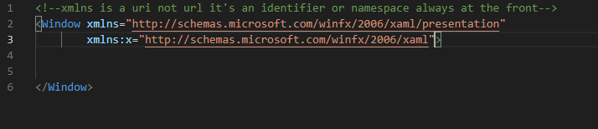
Xaml files
All xaml files must contain the following xmlns and xmlns:x where they are identifier and not links.

Slide 16
Xaml links
XAML overview - WPF .NET | Microsoft Learn

Slide 17
Commonly used class in xaml for pyRevit
<Grid> </Grid>
<ScrollViewer> </ScrollViewer>
<StackPanel> </StackPanel>
<TextBlock> </TextBlock>
<TextBox> </TextBox>
<Button />
<Image />

Slide 18

Data transfer xaml to python
To get a input from the user in xaml and transfer it to python you use <TextBox> which allows the user the alter the values within the <TextBox> and giving it a id or name using x:Name, in which you can use to call in python.

Slide 19
Data transfer python to xaml
Create a empty <TextBlock> or <TextBox> give it a ‘Name’ so that python can find it use it. In the python script use the built in method called .FindName() to find the <TextBlock> based off of ‘Name’ and change the value.

